Slide 1

Desk Stand Up Reminder
Navarro, Rod Geryk C.
CPE160P - 4– A1

Slide 2
Introduction
Prolonged periods of sitting are associated with various health issues, highlighting the need for regular movement in daily routines.
The Desk Stand Up Reminder project utilizes an Arduino Uno microcontroller and integrates components like a 4-bit seven-segment display, an LCD I2C 1602, LEDs, a buzzer, and an ultrasonic sensor to encourage users to stand and move at regular intervals.
Following the 20-8-2 rule, the system promotes a balanced work habit of sitting for 20 minutes, standing for 8 minutes, and moving for 2 minutes in each 30-minute cycle, with users able to adjust their sitting and standing times according to preference.
The ultrasonic sensor enables hands-free activation or reset of the system, and the project illustrates the practical application of embedded system skills while fostering a healthier, more active lifestyle.

Slide 3
OBJECTIVES
To be able to demonstrate and create a stand-up reminder using Arduino R3.
To be able to apply embedded system in reminding the user when to stand-up if the user sits for a long period of time using LCD, and 4- bit seven segment display, as well as the use buttons, ultrasonic sensor and a buzzer.
To be able to effectively remind the user when the time to stand up especially if the user has the habit of sitting for a long period of time or has a work that allows the user to sit for a long time.
To be able to use the skills learned and the functionality of at least five of the seven embedded system and design experiments.

Slide 4
MATERIALS
1x Arduino kit
1x Arduino R3
5x Switch/buttons w/ resistors
1x LCD (16x2)
1x 4-digit seven segment display w/ resistors
2x LEDs w/ resistors
1x Ultrasonic sensor
1x Buzzer w/resistor

Slide 5
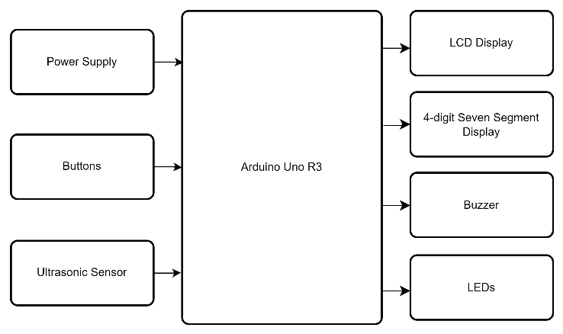
Block Diagram

Slide 6
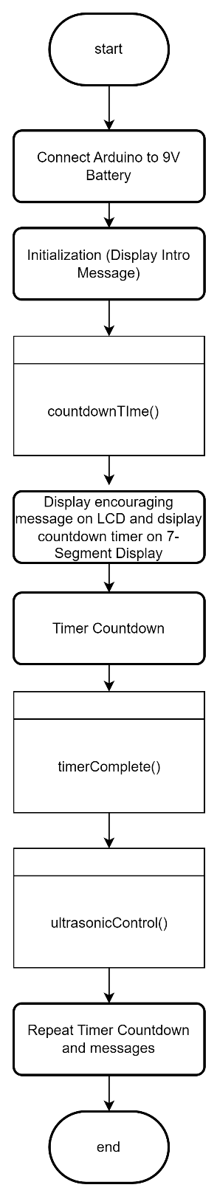
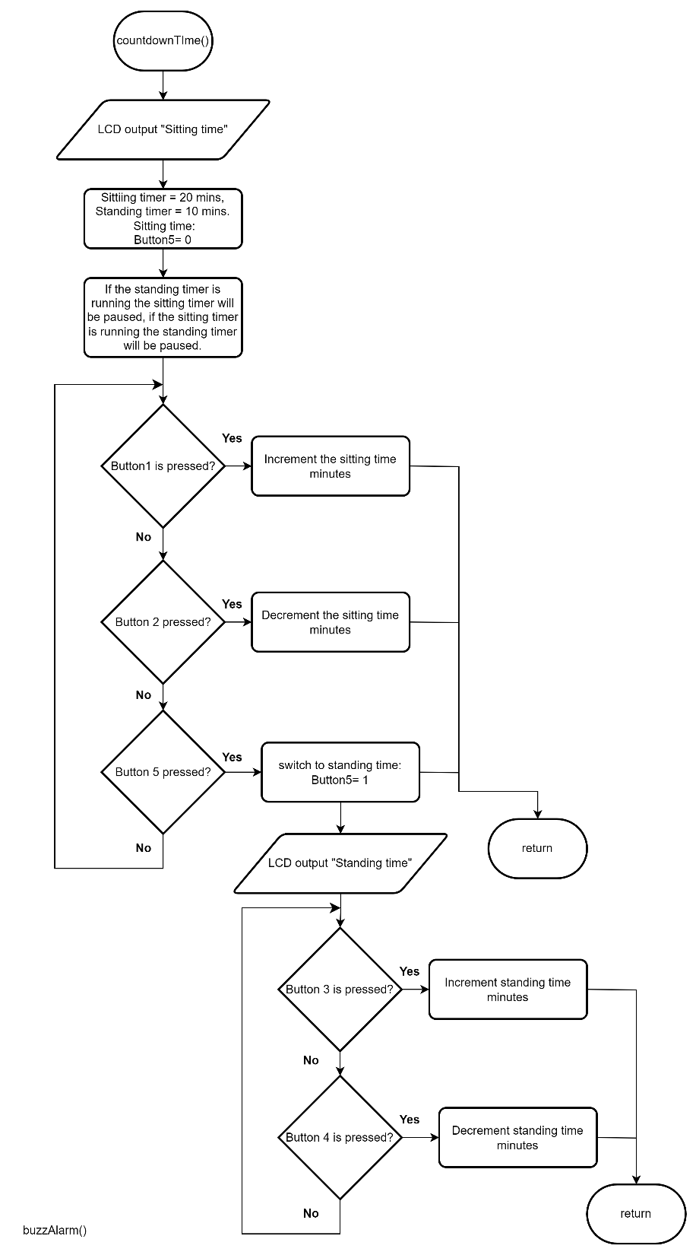
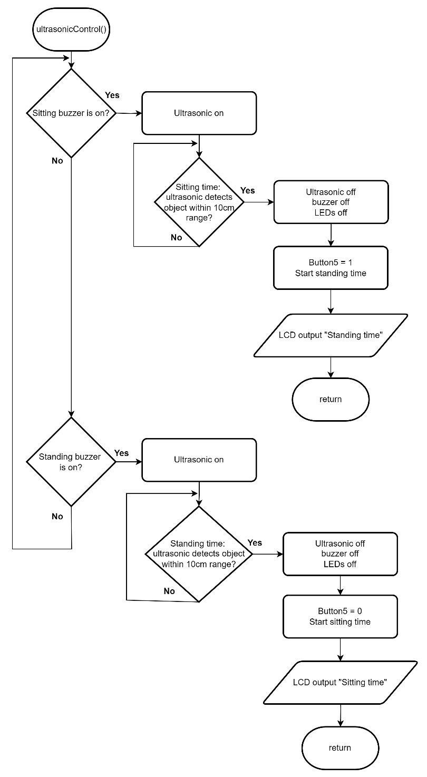
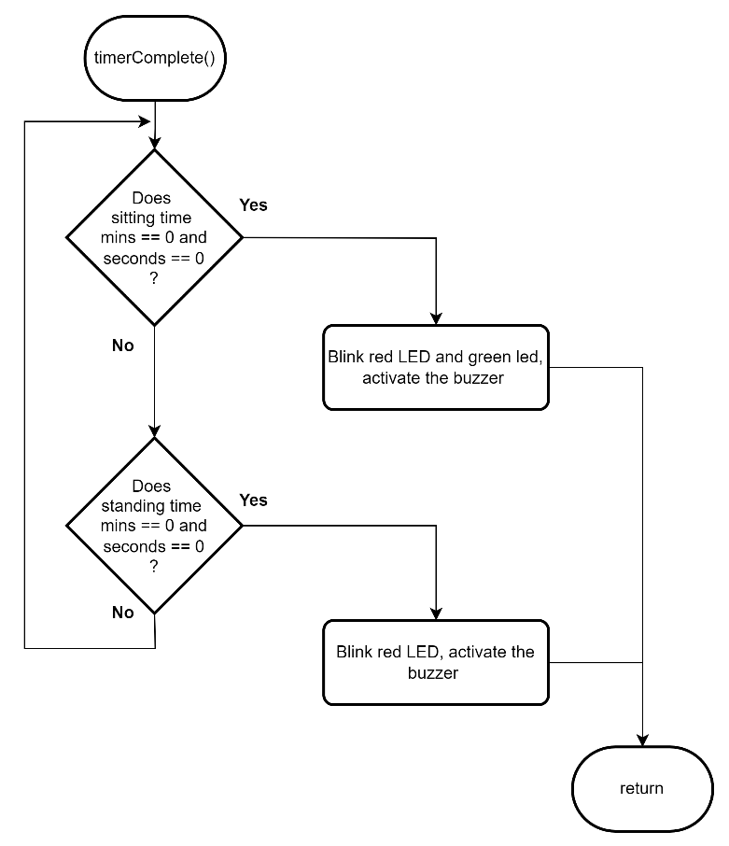
Flowchart

Slide 7
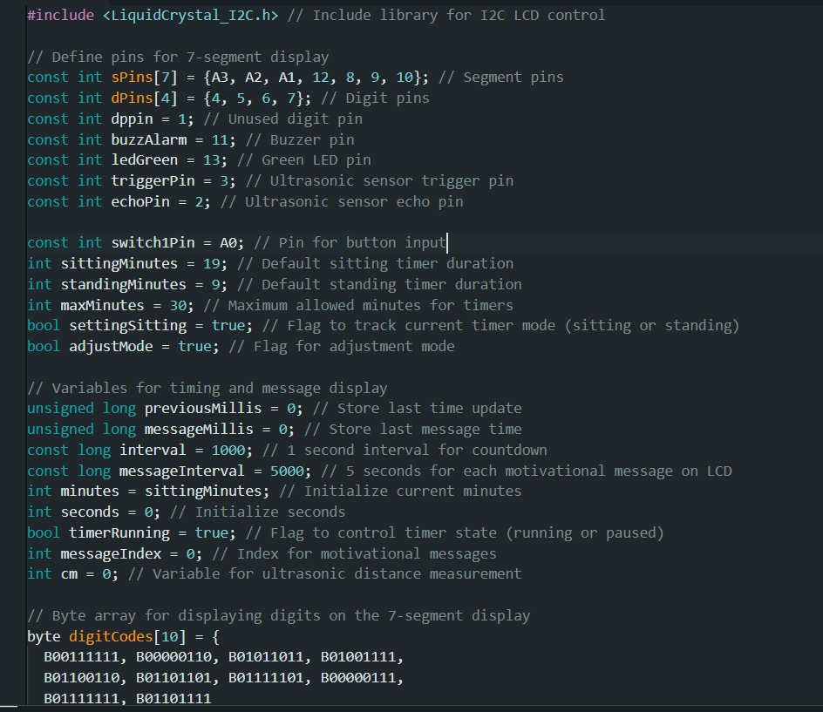
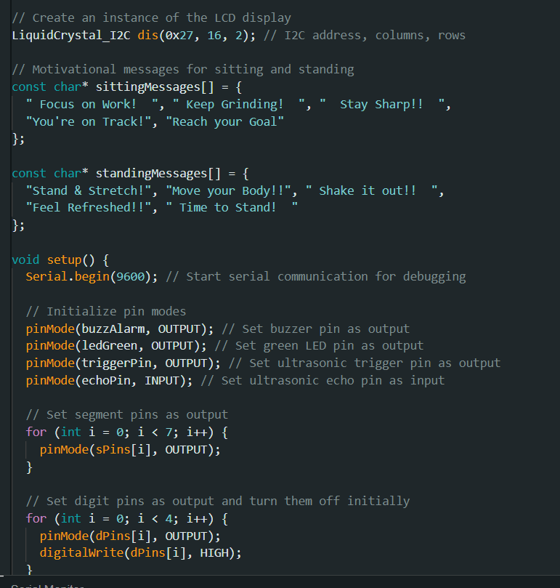
PROGRAM LISTING

Slide 8
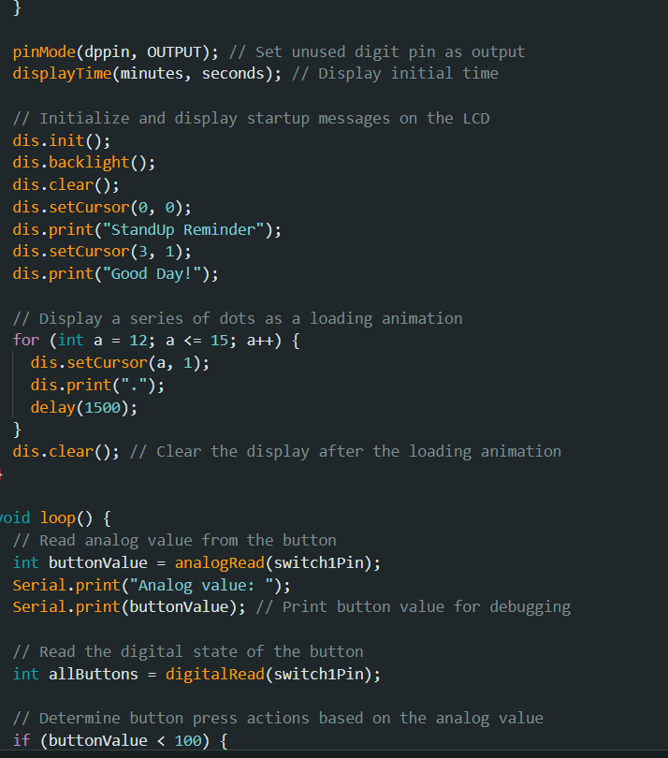
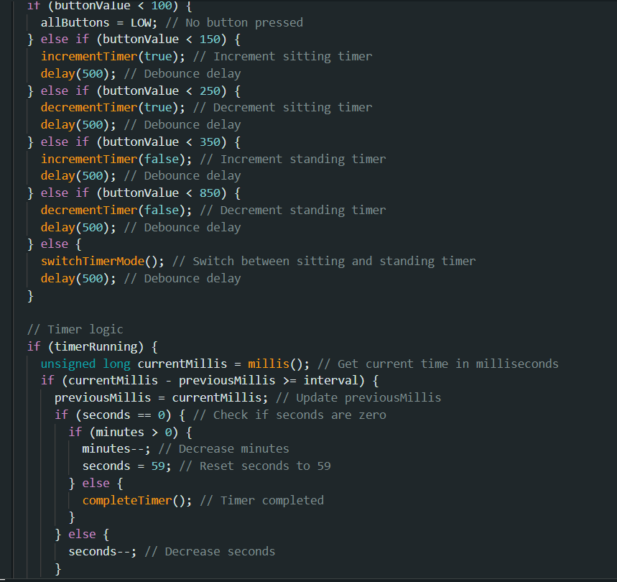
PROGRAM LISTING

Slide 9
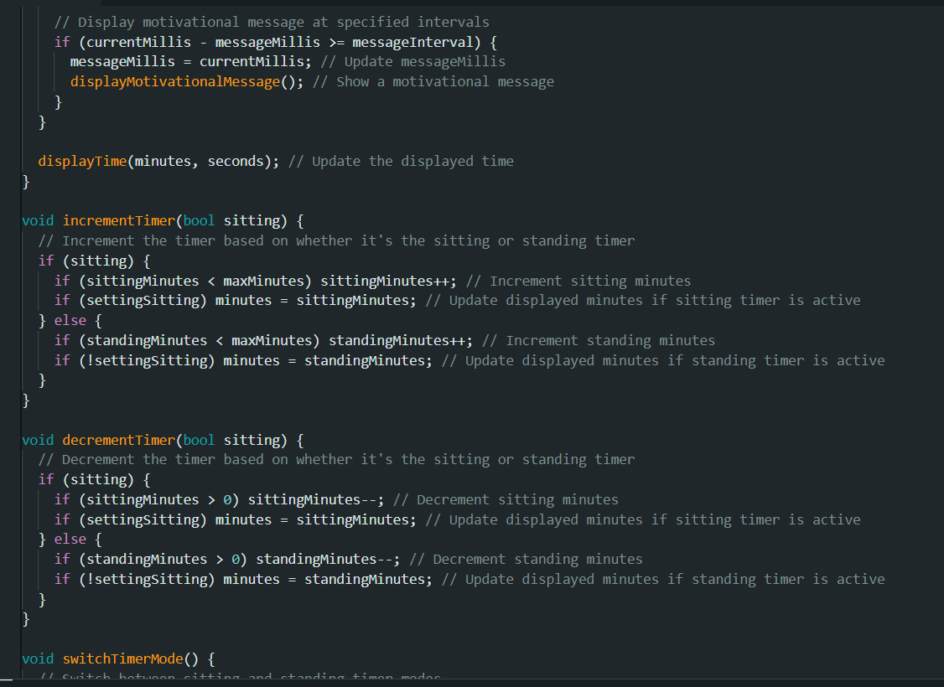
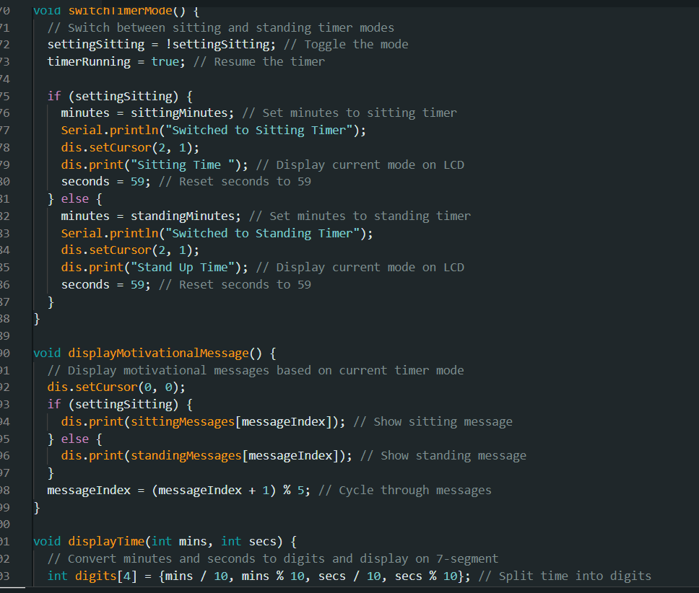
PROGRAM LISTING

Slide 10
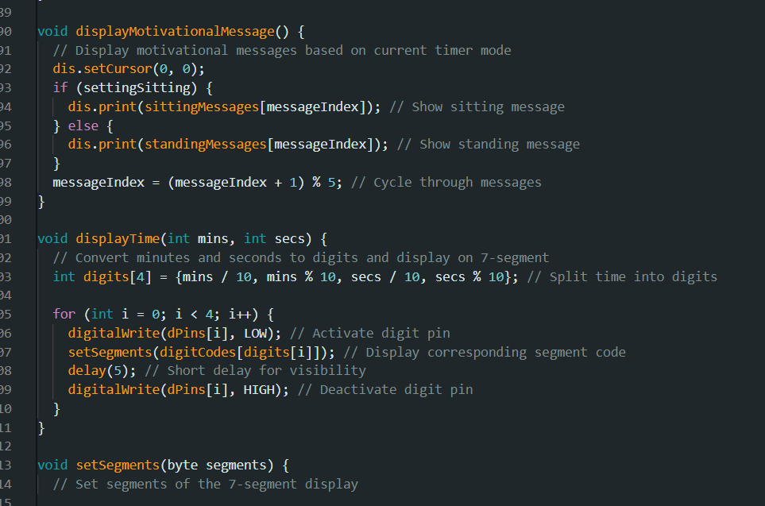
PROGRAM LISTING

Slide 11
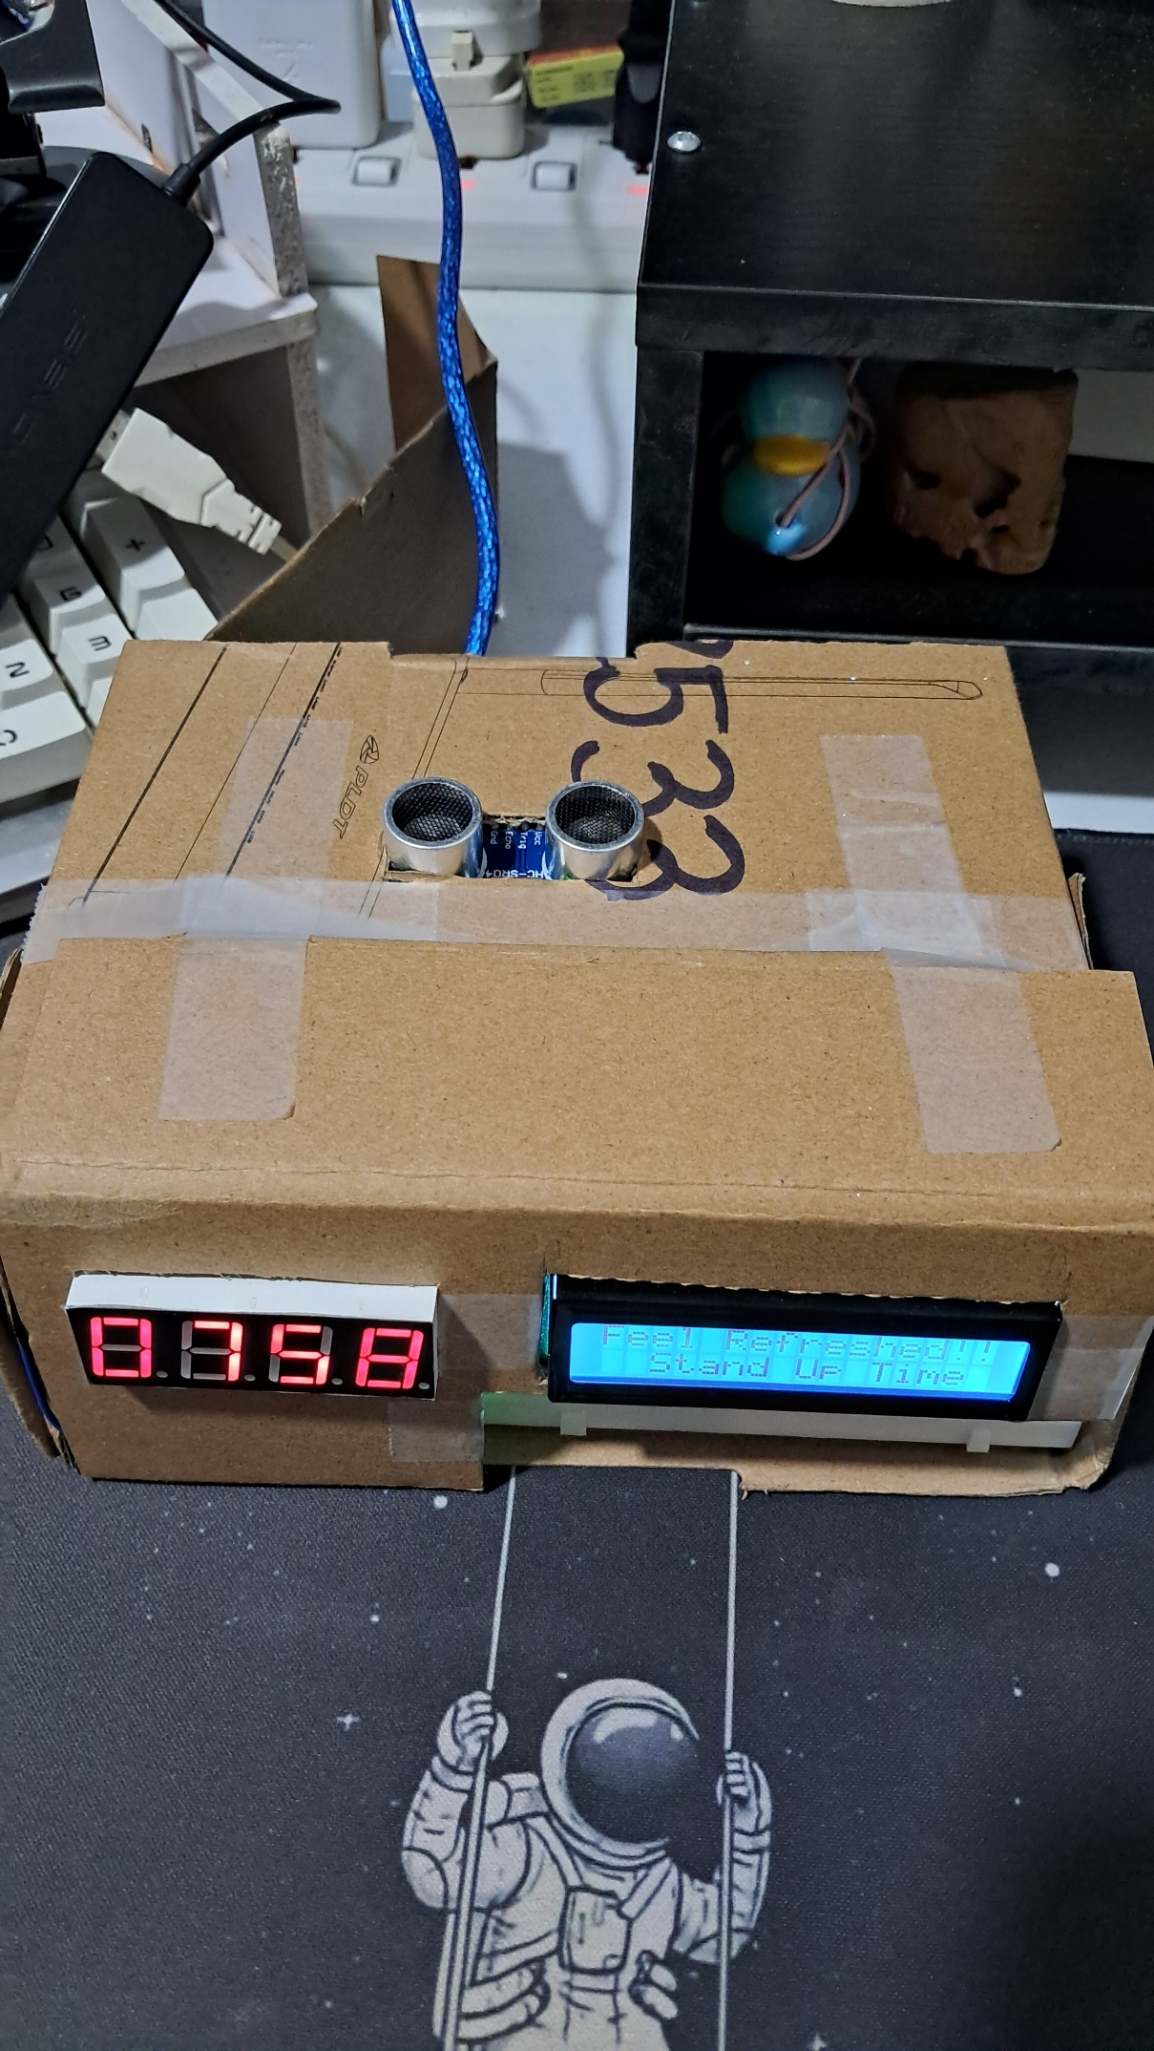
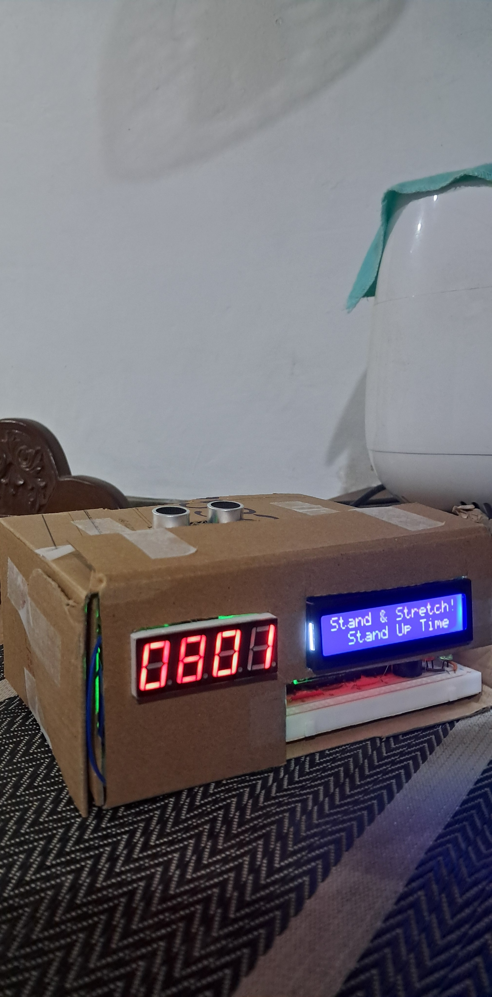
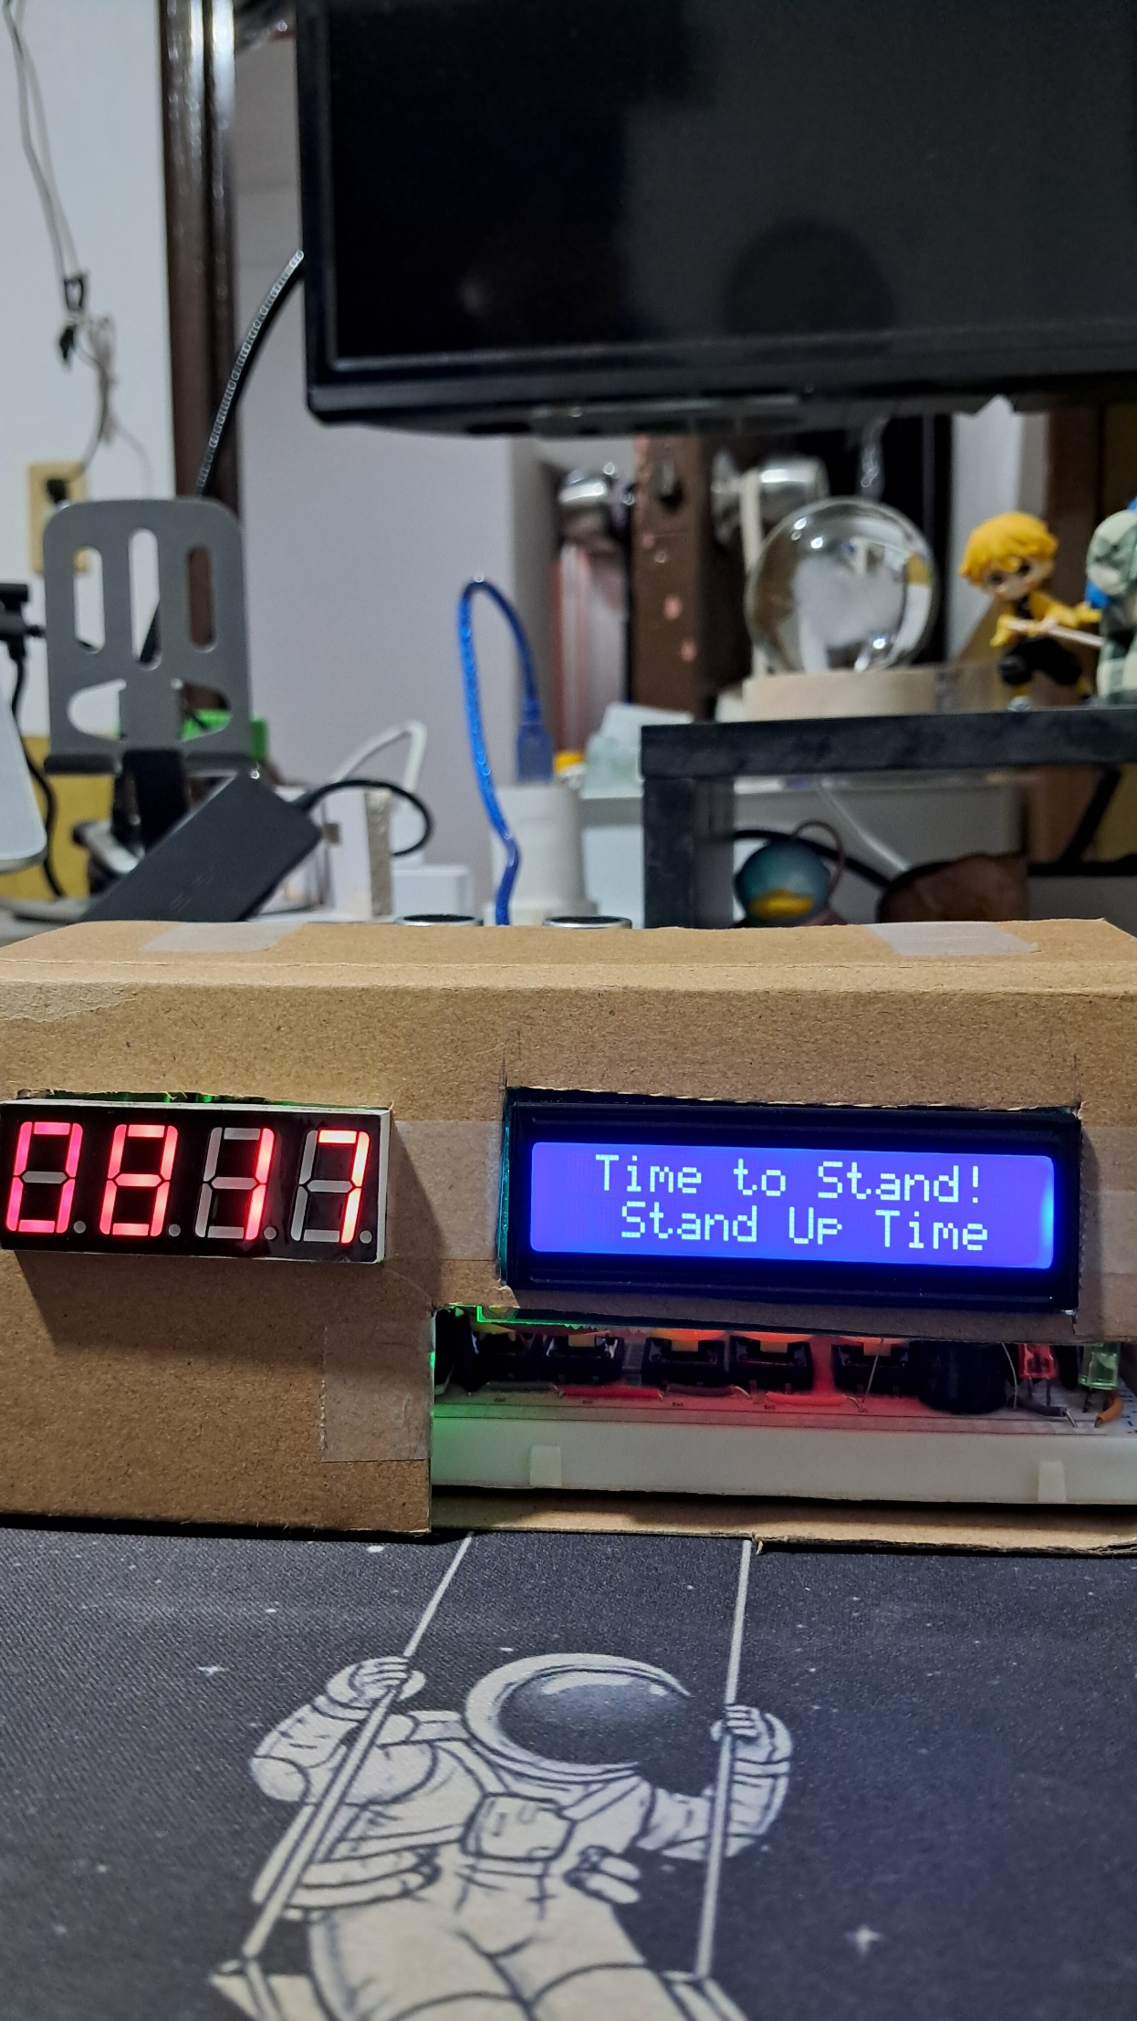
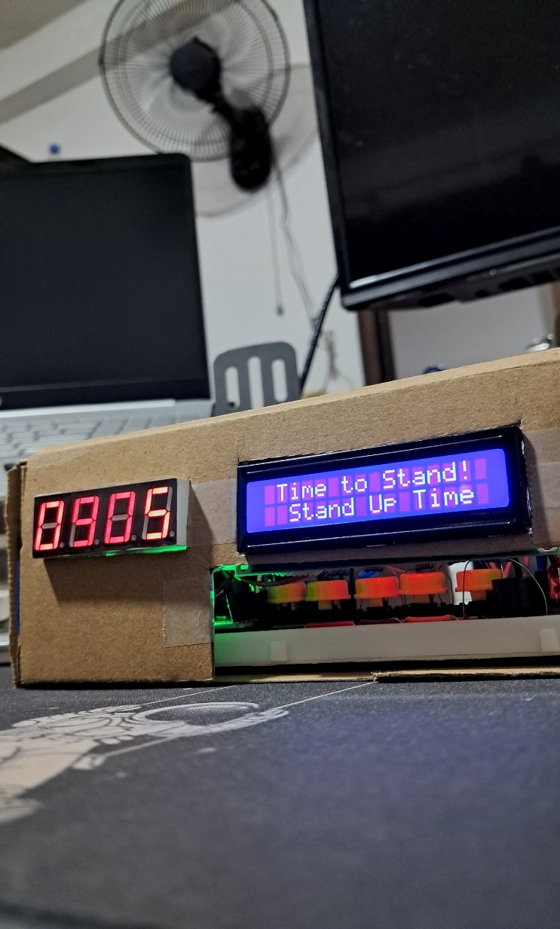
Prototype Demonstration

Slide 12
THANK YOU!

